Slide 1
RL seminar
Boyeon, Kim
2023. 11. 9.

Slide 2
Done List
SLIAR
Penalty term check
Reward = `- I - penalty`
Default initial
Initial `He`
Reference check
Reward1 = `- I`
Reward2 = `- I - penalty`

Slide 3

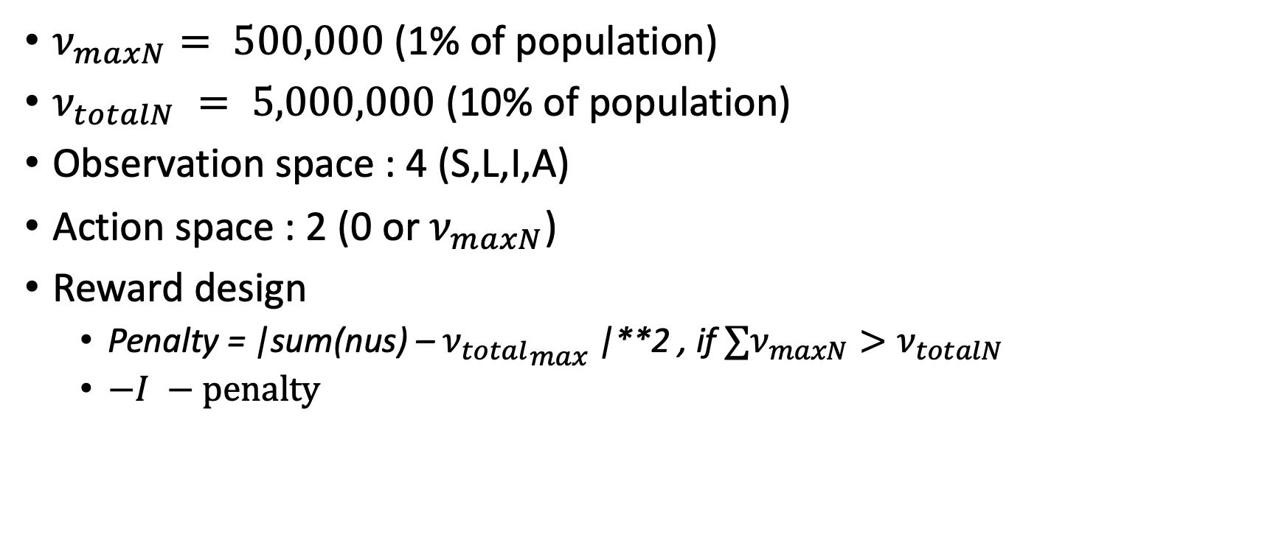
Set the environment for DQN in SLIAR
Reward : $`−I −penlaty`$
$ν_{maxN}⁡= 500,000$ (1% of population)
$ν_{totalN} = 5,000,000$ (10% of population)
Observation space : 4 (S,L,I,A)
Action space : 2 (0 or${ ν}_{maxN}$)
Reward design
Penalty = |sum(nus) – ${ν_{total}}_{max}$|**2 , if $∑ν_{maxN}>ν_{totalN}$
$−I −penalty$

Slide 4
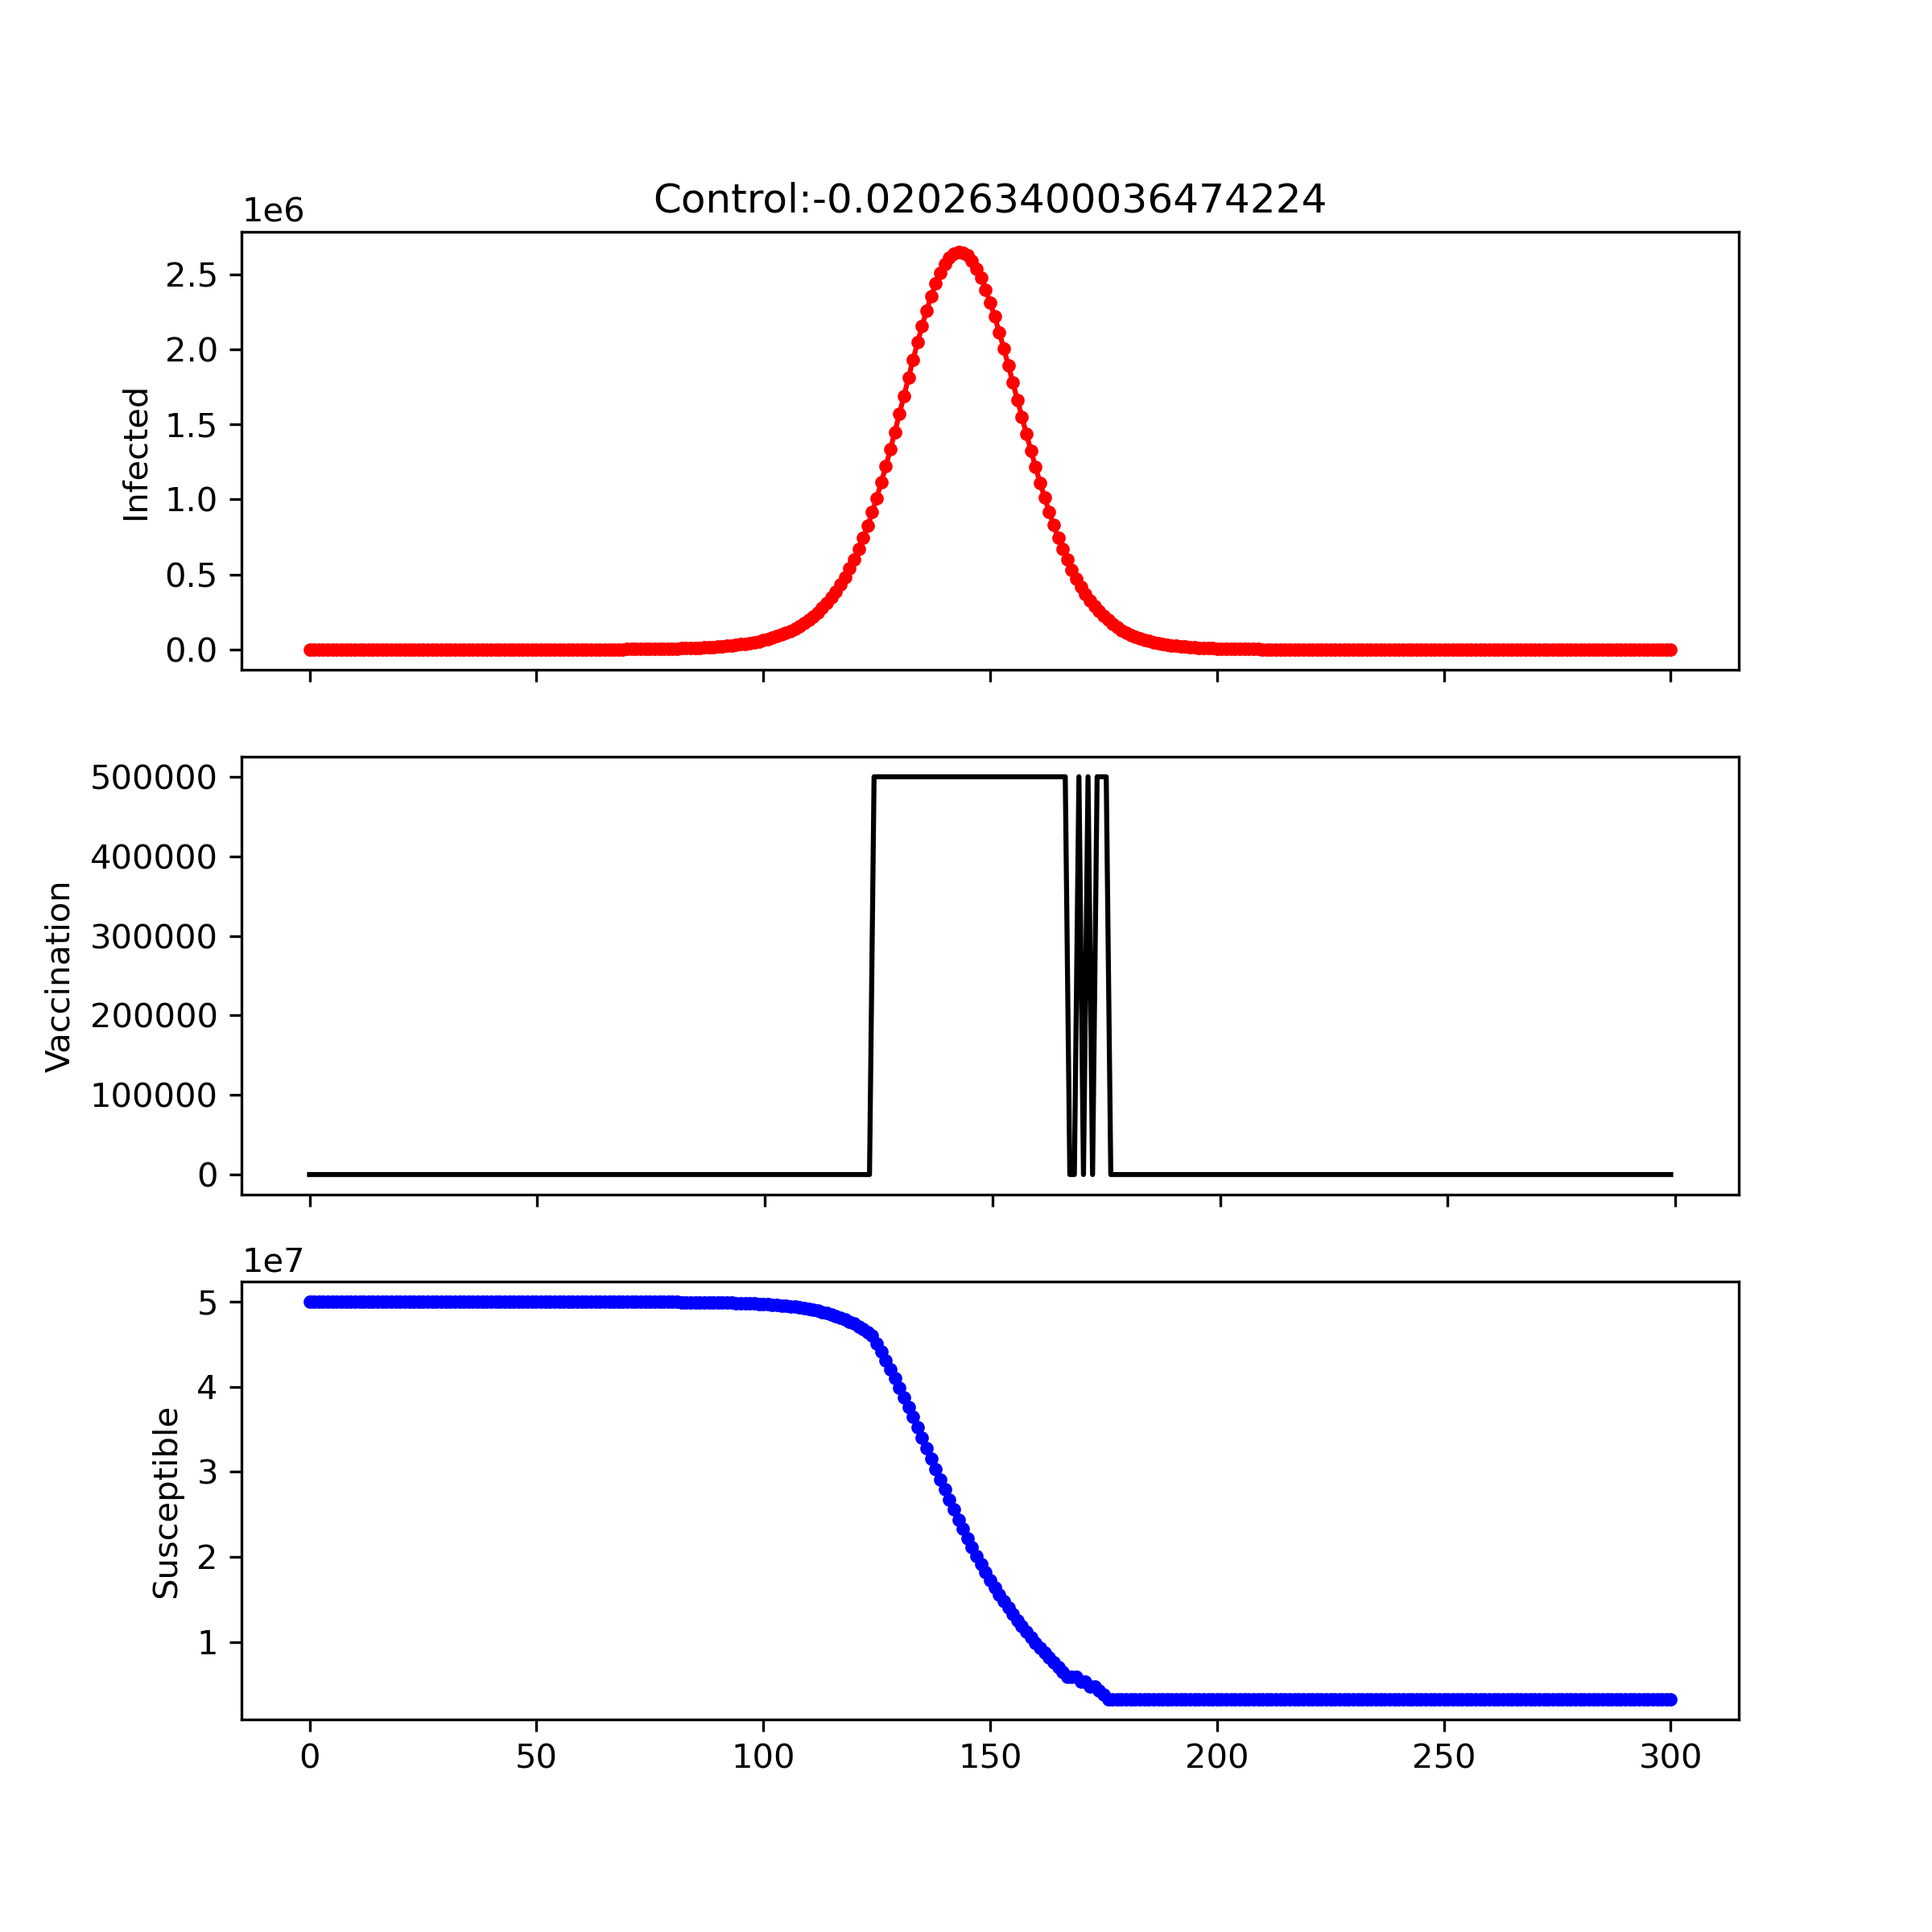
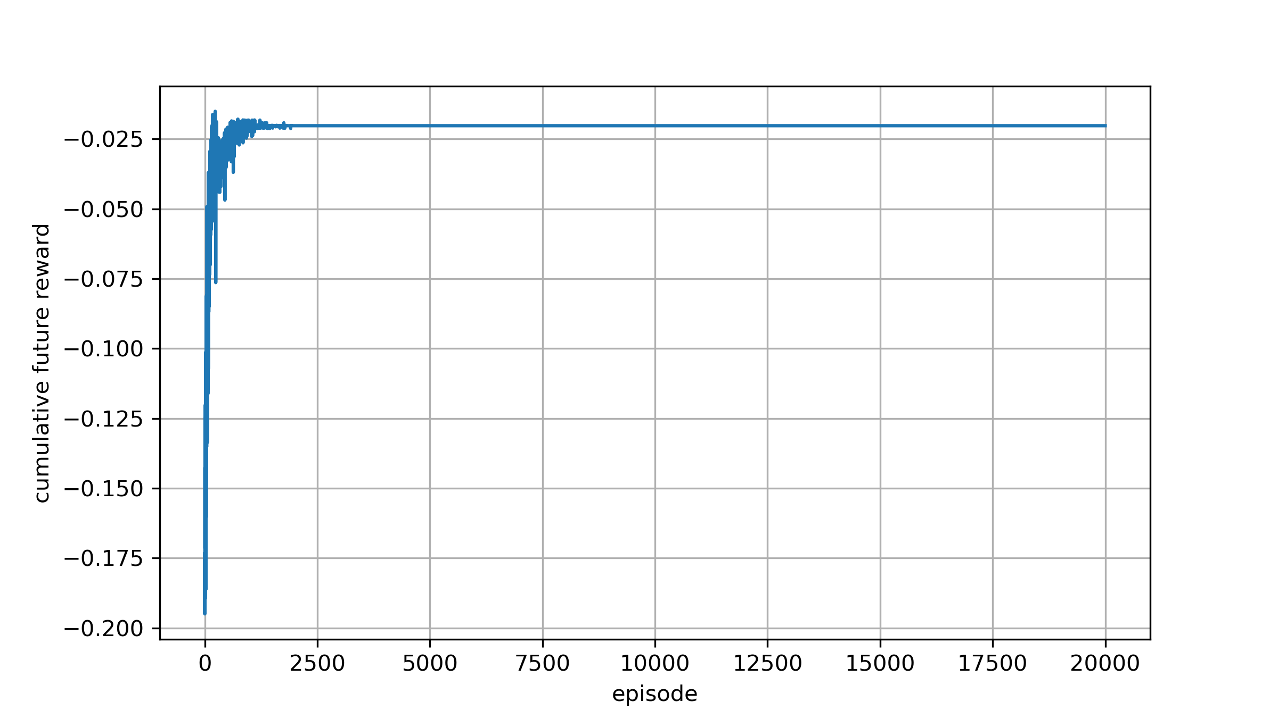
Learning rate : 1e-6 Reward design : −𝑰 – penalty Network initial : `Default` Scale = 25e-17
Reward : $`−I −penlaty`$

Slide 5
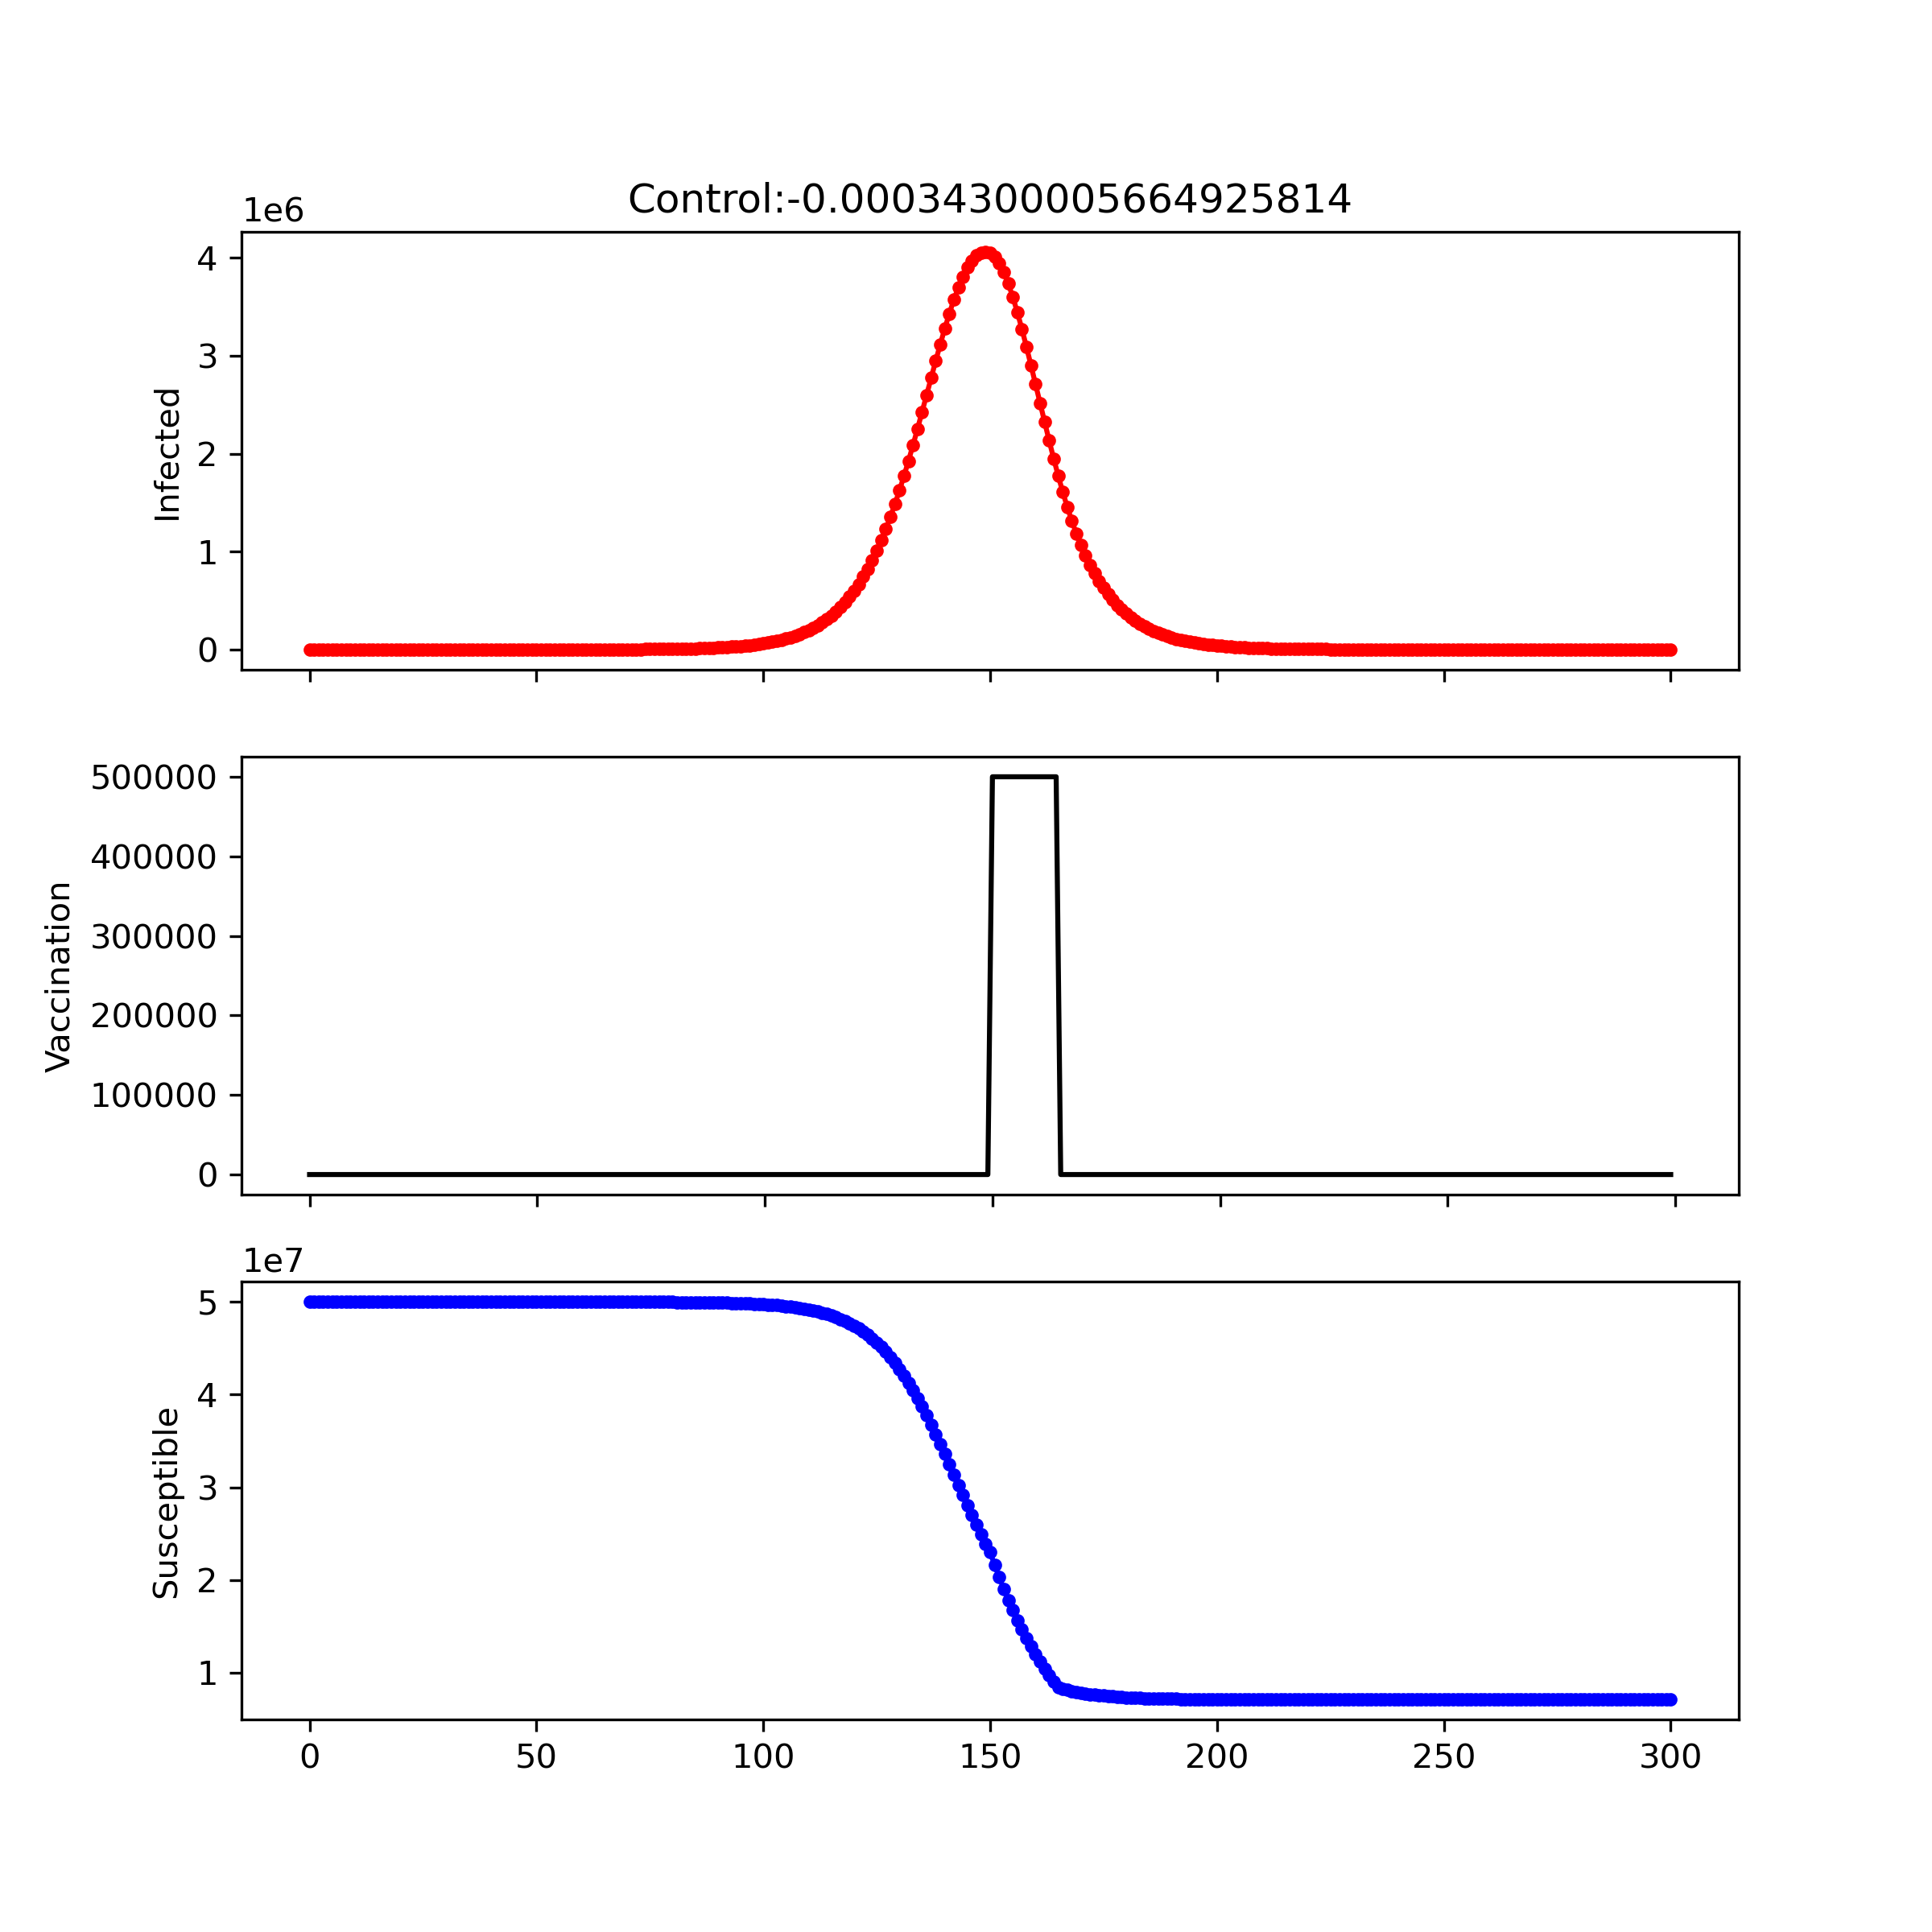
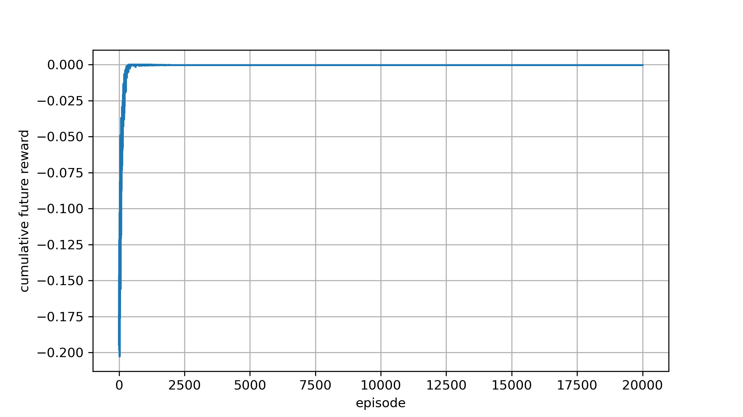
Learning rate : 1e-6 Reward design : −𝑰 – penalty Network initial : `He` Scale = 25e-17
Reward : $`−I −penlaty`$
Notes:
1
1e7
5e7

Slide 6
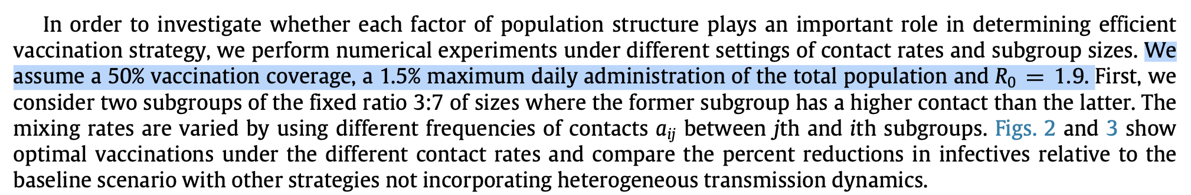

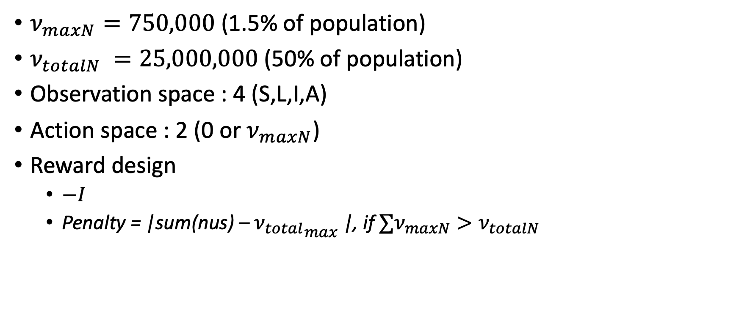
Set the environment for DQN in SLIAR
Reward : $`−I`$
$ν_{maxN}⁡=750,000$ (1.5% of population)
$ν_{totalN} =25,000,000$ (50% of population)
Observation space : 4 (S,L,I,A)
Action space : 2 (0 or $ν_{maxN}$)
Reward design
$−I$
Penalty = |sum(nus) – ${ν_{total}}_{max}$|, if $∑ν_{maxN}>ν_{totalN}$

Slide 7
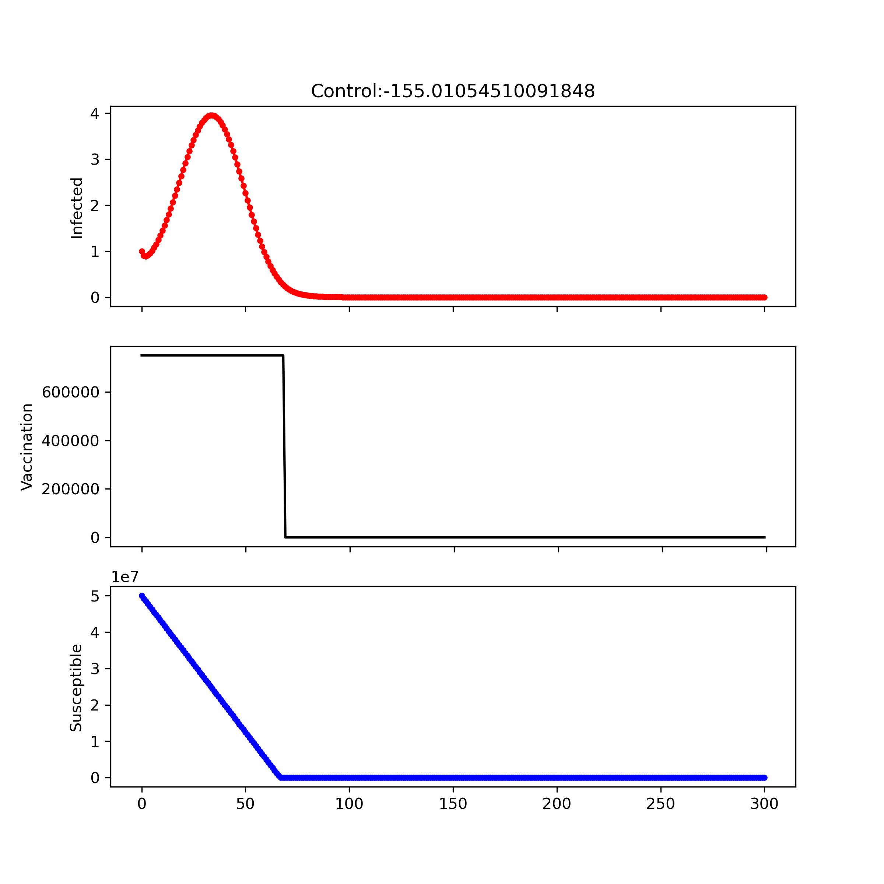
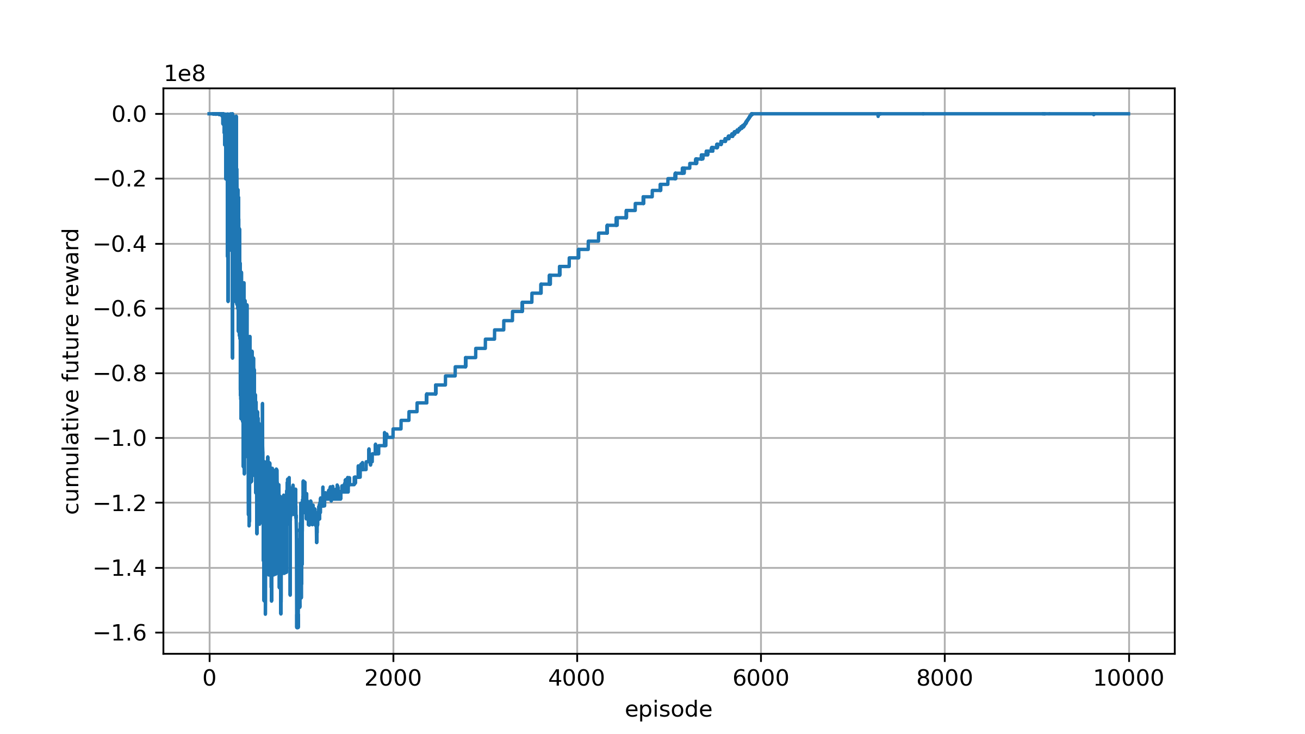

Learning rate : 1e-6 Reward design : −𝑰 Network initial : `default` Scale = 1
Reward : $`−I `$
Notes:
67days : full vaccine
750,000 * 66 = 49,500,000
750,000 * 67 = 50,250,000 약 5천만

Slide 8
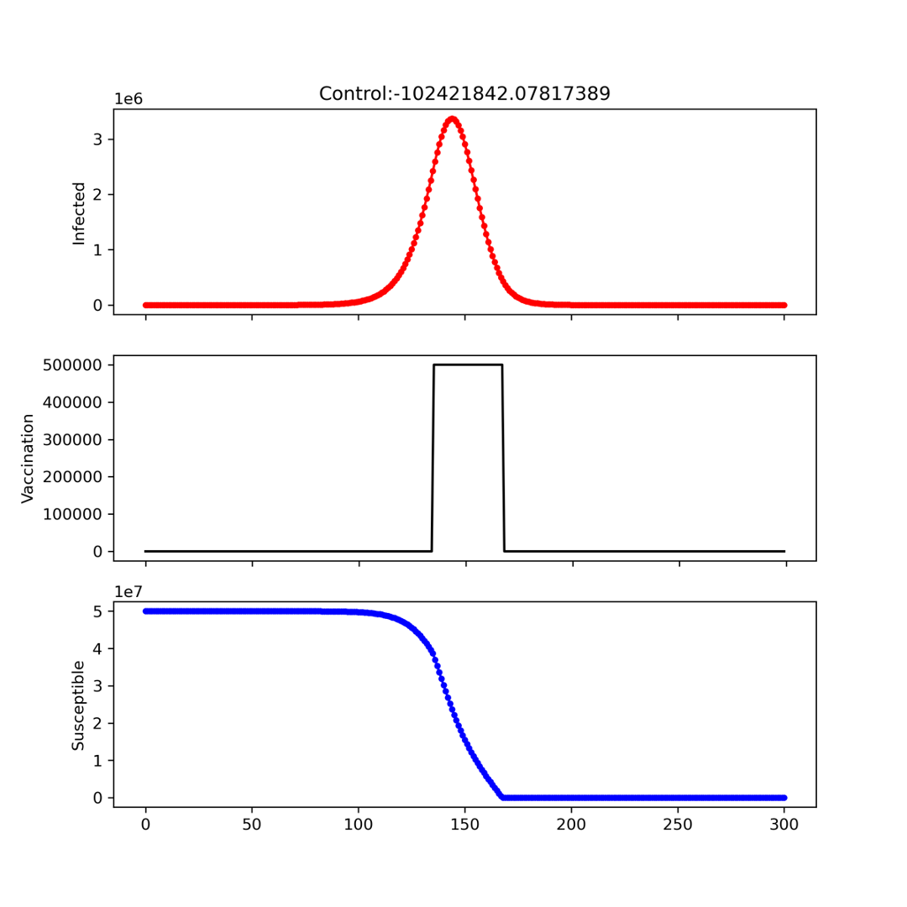
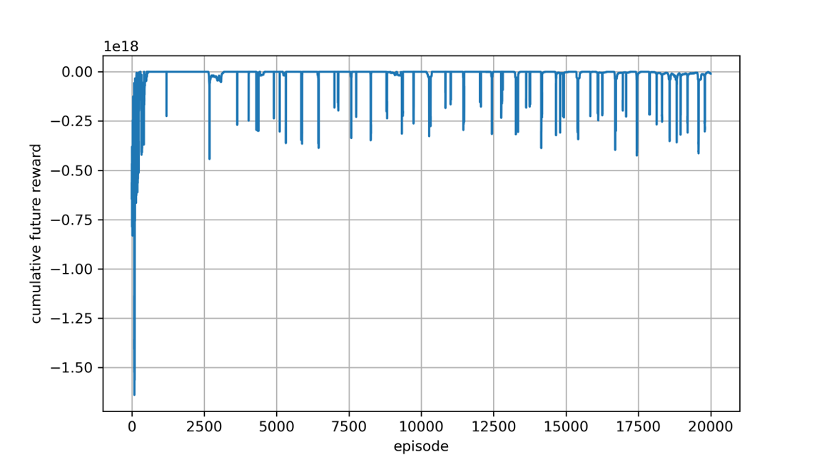

Learning rate : 1e-6 Reward design : −𝑰 – penalty Network initial : `default` Scale = 1
Reward : $`−I−penalty `$
Notes:
67days : full vaccine
750,000 * 66 = 49,500,000
750,000 * 67 = 50,250,000 약 5천만

Slide 9
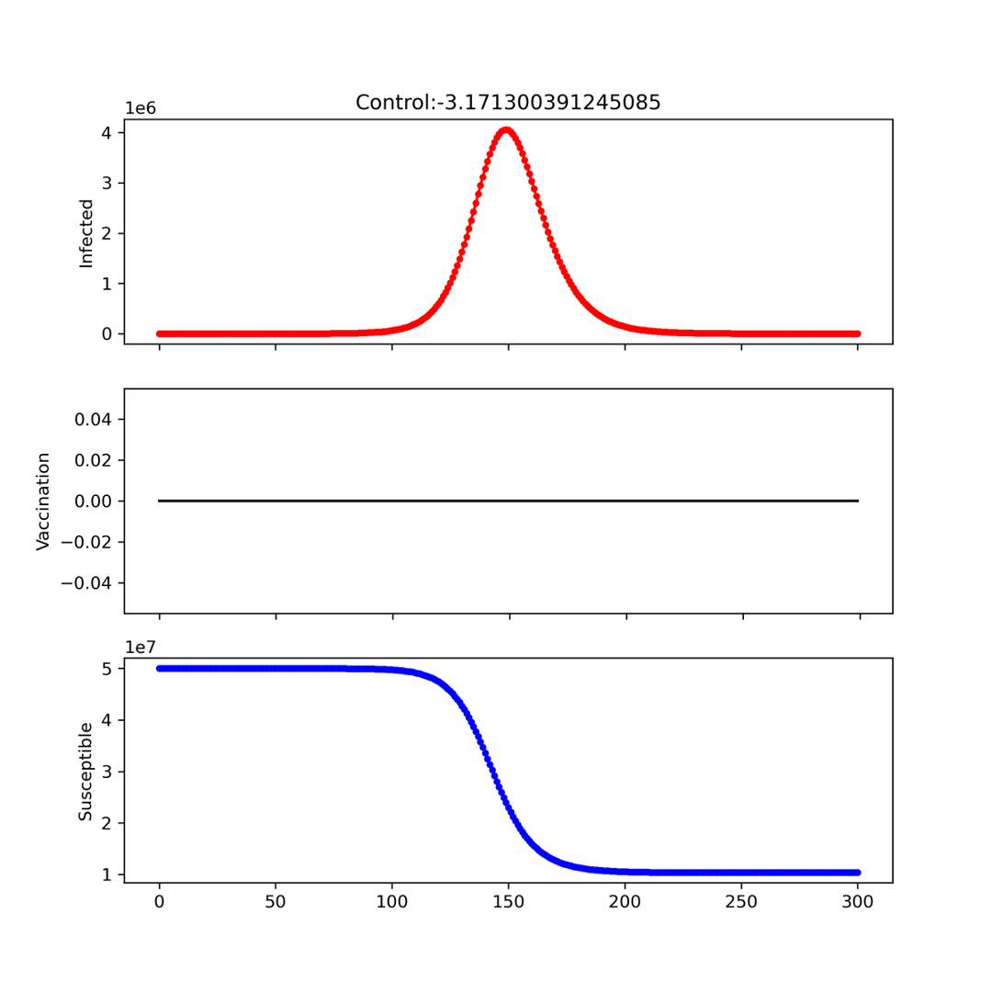
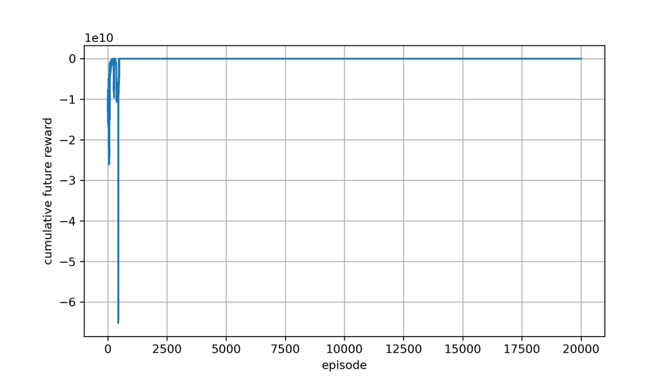
Learning rate : 1e-6 Reward design : −𝑰 – penalty Network initial : `default` Scale = 5e7
Reward : $`−I−penalty `$
Notes:
67days : full vaccine
750,000 * 66 = 49,500,000
750,000 * 67 = 50,250,000 약 5천만

Slide 10
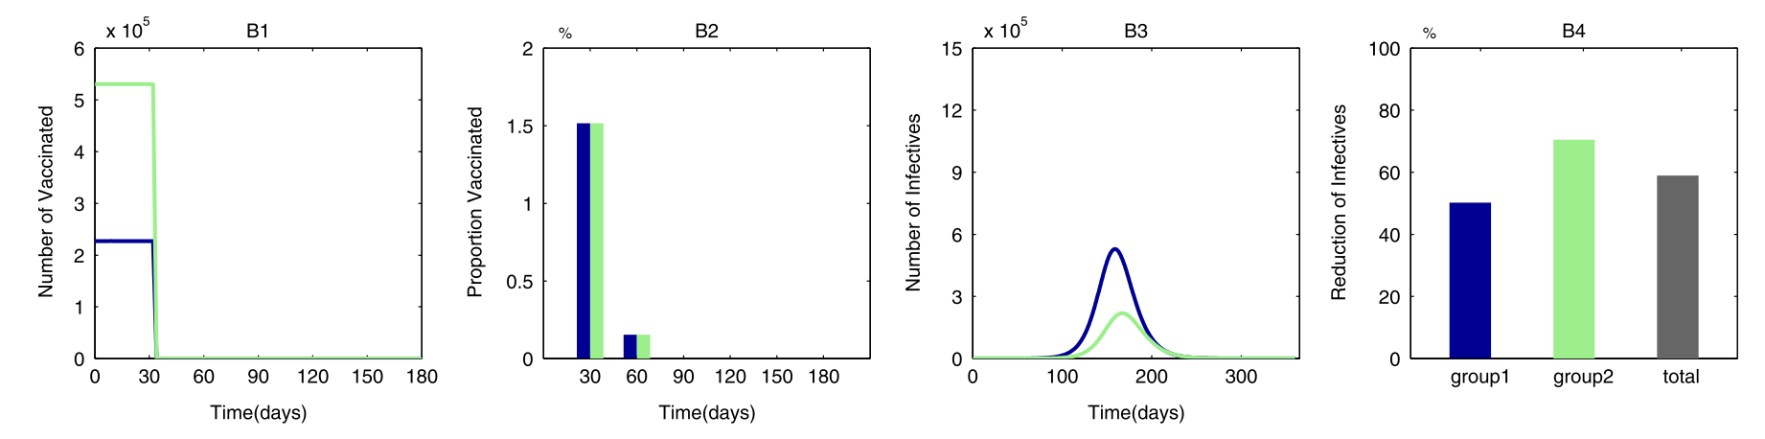
Reference
Reward : $`−I−penalty `$
Notes:
67days : full vaccine
750,000 * 66 = 49,500,000
750,000 * 67 = 50,250,000 약 5천만

Slide 11
Next Todo
Subgroup 1 Size : 5e7 * 0.7
Normalization (non scaling)
Initial setting - ‘He’ Initialization (relu 특화)

